Slide 1
COUNTING CROWD WITH CNN- SOCIAL DISTANCING PROJECT
Presented by: SENTHILBALAN R P
III year,KVCET
NM ID-au421221243036
Email ID-senthilbalan03@gmail.com

Slide 2

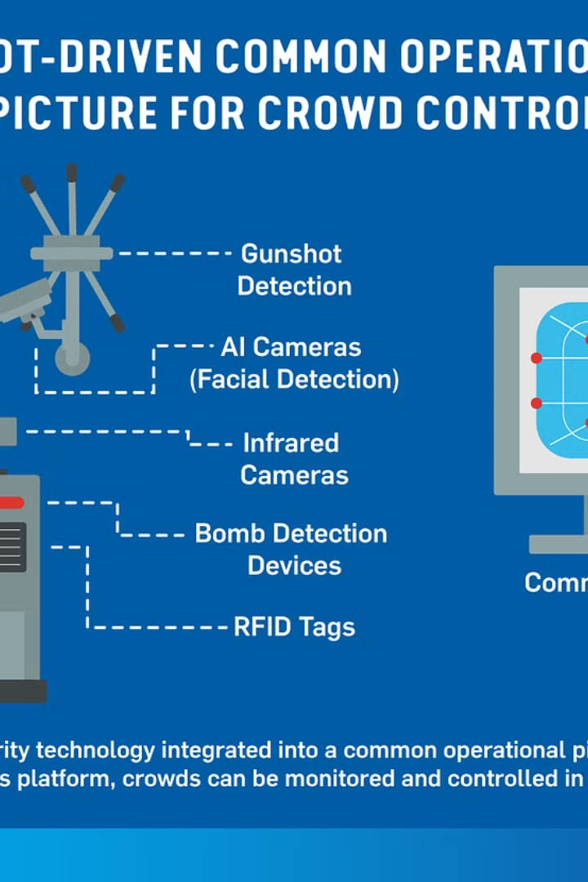
Proposed System
Our innovative crowd counting system utilizes the latest convolutional neural network (CNN) technology to accurately monitor and maintain social distancing in public spaces. By precisely detecting and tracking individuals, we can provide real-time analytics to help manage crowds safely and efficiently.

Slide 3

Problem statement
Need for accurate crowd counting
Limitations of manual counting
Lack of automated solutions
Maintaining social distancing during events and gatherings has become crucial. Reliable crowd counting is essential to ensure compliance with safety protocols.
Traditional manual methods of counting crowds are labor-intensive, subjective, and prone to inaccuracies, especially in large or densely populated areas.
Current automated crowd counting systems often struggle with occlusions, varying lighting conditions, and complex crowd dynamics, limiting their effectiveness in real-world scenarios.

Slide 4

Proposed solution
Develop a computer vision-based system using Convolutional Neural Networks (CNNs) to accurately count the number of people in a crowd while maintaining social distancing.
Leverage object detection and instance segmentation techniques to identify and track individual people in the scene.
Implement a smart counting algorithm that can handle overlapping people, occlusions, and other challenging crowd scenarios.

Slide 5
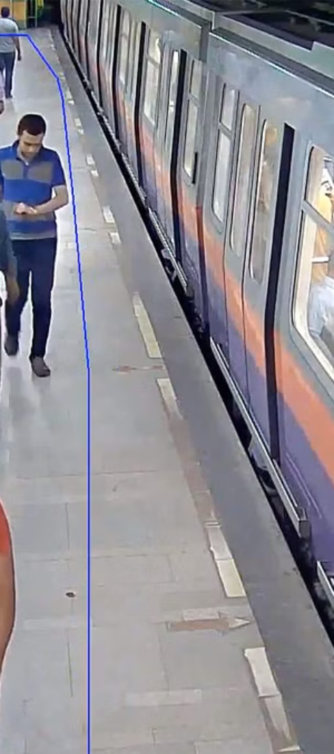
System Approach
1
Data Collection
Leverage existing surveillance cameras and computer vision algorithms to continuously monitor crowds and record crowd density data.
2
Social Distancing Analytics
Analyze the captured data to detect social distancing violations and generate alerts for crowd management.
3
Adaptive Monitoring
Dynamically adjust camera positioning and detection algorithms to optimize the system for changing crowd patterns and environments.

Slide 6
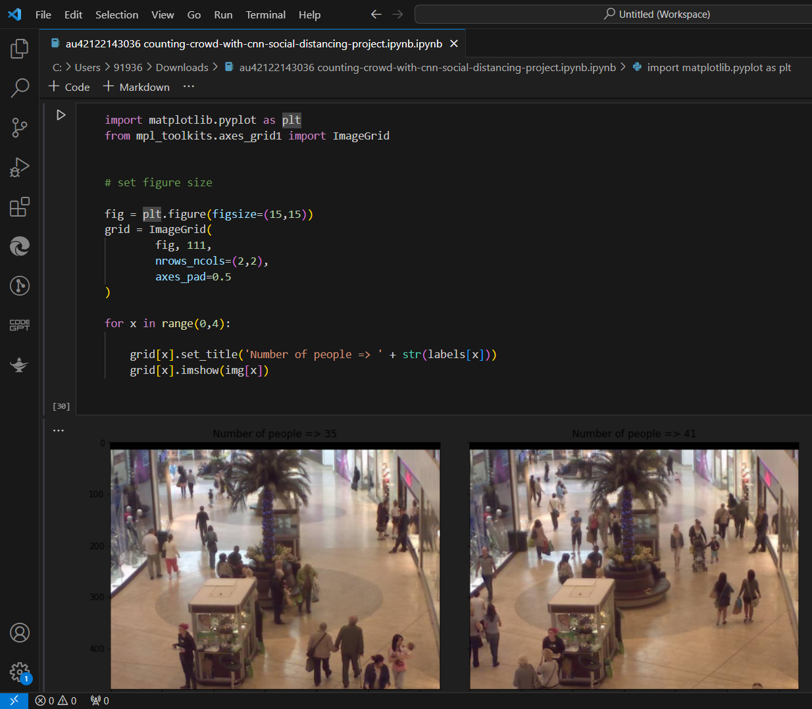
Algorithm and Deployment
The proposed system utilizes a convolutional neural network (CNN) algorithm to detect and count people in real-time. The algorithm is trained on a large dataset of images to accurately identify individuals while maintaining their privacy.
The trained model is then deployed on edge devices, such as security cameras, to enable automated crowd monitoring and social distancing tracking. This on-device processing ensures low latency and secure data handling, without the need to transmit sensitive information to a central server.

Slide 7

Training and process
To train the CNN model for crowd counting, we collect a diverse dataset of images with varying crowd densities. The dataset includes images captured in different environments, lighting conditions, and camera angles to ensure the model's robustness. We then preprocess the images and annotate the ground truth crowd counts for each image.
The CNN model is trained using state-of-the-art techniques, such as transfer learning and data augmentation, to improve its performance. The training process involves fine-tuning the model's parameters to minimize the error between the predicted and the ground truth crowd counts. We monitor the model's performance on a validation set during training to prevent overfitting and ensure its generalization to new data.

Slide 8
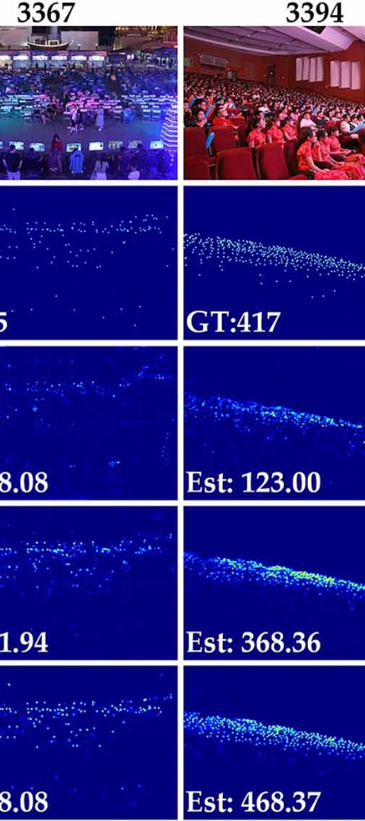



Prediction Process
Data Preprocessing
Raw data is cleaned, normalized, and transformed into a format suitable for the CNN model.
Model Inference
The trained CNN model takes the preprocessed data as input and generates crowd count predictions.
Visualization
The crowd count predictions are overlaid on the input images for visual feedback and analysis.

Slide 9
Result & Conclusion
1
Accurate Crowd Counting
2
Real-Time Monitoring
The proposed CNN-based system accurately counted the number of people in a crowd, even with social distancing measures in place.
The system provided real-time monitoring of crowd density, allowing for proactive crowd management and adherence to safety guidelines.
3
Adaptable to Environments
4
Practical Implementation
The system demonstrated flexibility in adapting to different crowd sizes, lighting conditions, and camera angles, making it versatile for various settings.
The efficient deployment and seamless integration of the system into existing infrastructure showcased its practical feasibility for real-world applications.

Slide 10
Future Scope
Improved Accuracy
1
Enhance the CNN model for more precise crowd counting.
Wider Applications
2
Extend the system to monitor crowd density in various settings.
Edge Computing
3
Integrate the model for real-time analysis on edge devices.
The future scope of this project involves improving the accuracy of the crowd counting model through further refinement and training. Additionally, the system can be extended to monitor crowd density in a wider range of settings, such as public events, transportation hubs, and urban areas. Integrating the model for real-time analysis on edge computing devices could also enable immediate response and decision-making in crowd management scenarios.

Slide 11



Reference
Literature Review
Algorithm Benchmarking
Open-Source Contributions
Examine prior research and publications related to crowd counting and social distancing technologies. Identify best practices and lessons learned from existing solutions.
Thoroughly test the performance of the proposed crowd counting algorithm against standard datasets and industry benchmarks. Analyze accuracy, efficiency, and robustness metrics.
Contribute the project's code, models, and documentation to open-source repositories. Encourage community engagement and collaboration to further advance the state-of-the-art.

